Slide 1

Lead Scoring Case Study
Abdul Wasi Stanikzai
Nikhita varma
Arpan Das

Slide 2

Problem Statement
X Education sells online courses to industry professionals.
X Education gets a lot of leads, its lead conversion rate is very poor. If they acquire 100 leads in a day, only about 30 of them are converted.
X wants to Identify most promising leads known as ‘Hot Leads’. i.e. the leads that are most likely to convert into paying customers so they can be targeted by Company’ sales team for better conversion rate
Objective/ Goal :
Build a model to assign a lead score that will help the Company X target lead conversion rate of around 80%.
Data
Leads dataset (based on form filled by leads) from the past with around 9000 data points
Leads dataset consists of various attributes deciding whether a lead will be converted or not.
The target variable, in this case, is the column ‘Converted’ - 0 means not converted and 1 implies converted
Data dictionary mentioning the details on the columns

Slide 3
Analysis/ Approach
Build a logistic regression to assign probability of conversion to the leads
Demonstrate the model holds good for train and test in statistical measures
Insights – Identify the lead score to target potential leads and driving factors for better conversion
Detailed Approach
Understand the Data
Data Preparation
Clean up of the data – select
Handling missing values/ nulls
Conversion of categorical variables (Yes/ No into 1/0, One-Hot Encoding for variables with more than two values
Removing the columns with minimal / zero variance
Outlier handling
Explanatory Data Analysis
Build model with selected features (RFE). Eliminate features with high p values, multi collinearity
Final Model Evaluation using metrices
Decide the threshold to be used , predict in training data set
Test with test dataset
Final Conclusion – with lead score to be used and critical attributes

Slide 4
Data preparation and Feature Engineering
Categorical Variables
Covert select to null as the option not selected by users
Categorical value columns with only yes/no converted to 1/0
['Do Not Email', 'Do Not Call', 'Search', 'Magazine', 'Newspaper Article', 'X Education Forums', 'Newspaper', 'Digital Advertisement', 'Through Recommendations', 'Receive More Updates About Our Courses', 'Update me on Supply Chain Content’, 'Get updates on DM Content', 'I agree to pay the amount through cheque', 'A free copy of Mastering The Interview’]
One hot encoding for Categorical values with more than two values
Deletions
Drop the columns with more than 50% missing values
'How did you hear about X Education', 'Lead Quality', 'Lead Profile’
Drop columns that were scores and indexes with 45% missing values as we don’t know how thy are calculated so imputing them with mean/median for so many null values will tweak the data
Asymmetrique Activity Index, Asymmetrique Profile Index, Asymmetrique Activity Score,Asymmetrique Profile Score
Drop city as 40% of values are null and there is no clear majority for the rest of values to impute – Mumbai 57% close to the missing values
Drop the columns with 0 or minimal variance as they wont add any insights
'Search','Magazine','Newspaper Article','X Education Forums','Newspaper','Digital Advertisement','Through Recommendations','Receive More Updates About Our Courses’, Update me on Supply Chain Content','I agree to pay the amount through cheque’,'What matters most to you in choosing a course’, Get updates on DM Content, Country
Drop unique identifiers as they wont play a role in regression model
Prospect ID', 'Lead Number'

Slide 5
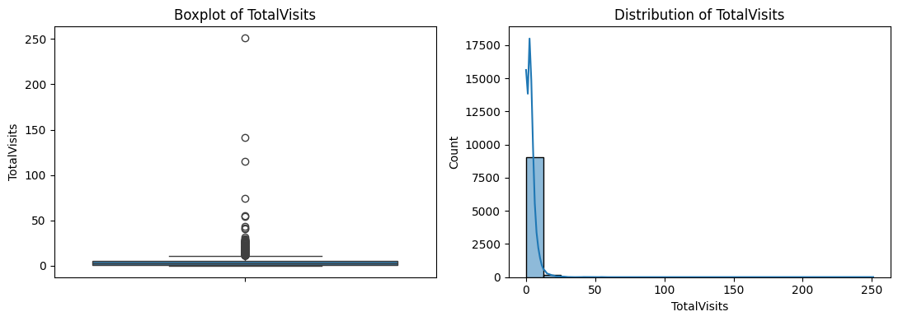
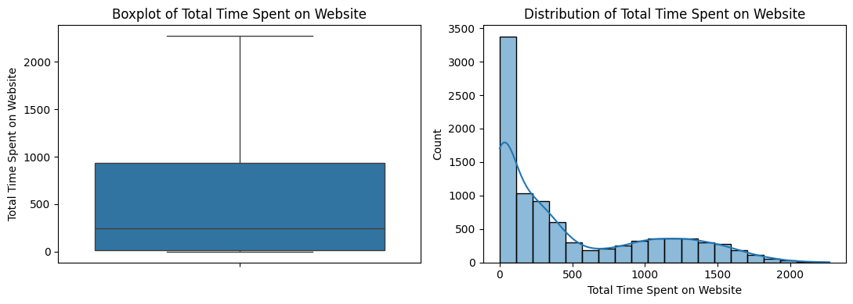
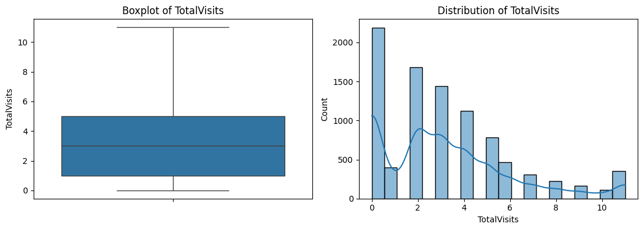
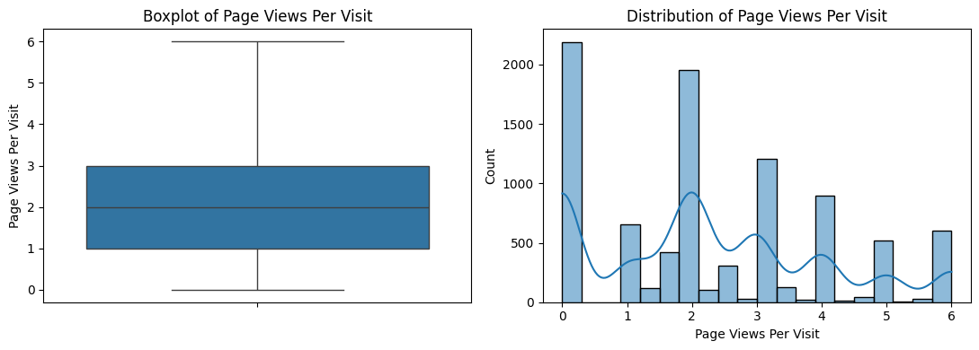
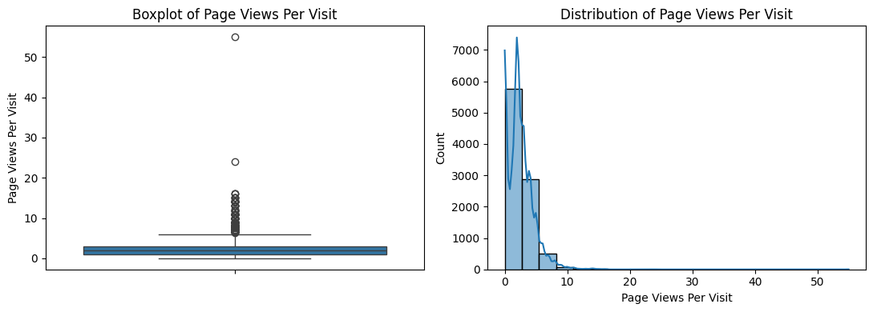
Data preparation and Feature Engineering – continued
Imputations
Impute the columns with specific values based on maximum frequency or logic
Specialization – Null were marked as Others as rest of the specialization have been considered
Occupation - Null were marked as Unemployed ( max occurrence) as 85% of data is Unemployed
Tags – Null were marked as 'Will revert after reading the email’ max occurrence
Last Activity had few nulls that were marked as ‘Email Opened’ max occurrence
The numerical columns TotalVisits and Page Views Per Visit have null values were imputed with Median
Outlier Handling
Drop the columns with more than 50% missing values
Numerical columns TotalVisits, ‘Total Time Spent on Website’, 'Page Views Per Visit’ had outliers
For better regression – outliers were deleted based on IQR approach
BEFORE
AFTER

Slide 6
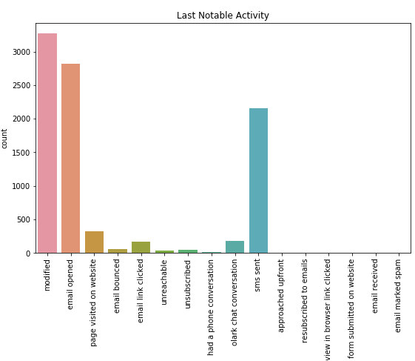
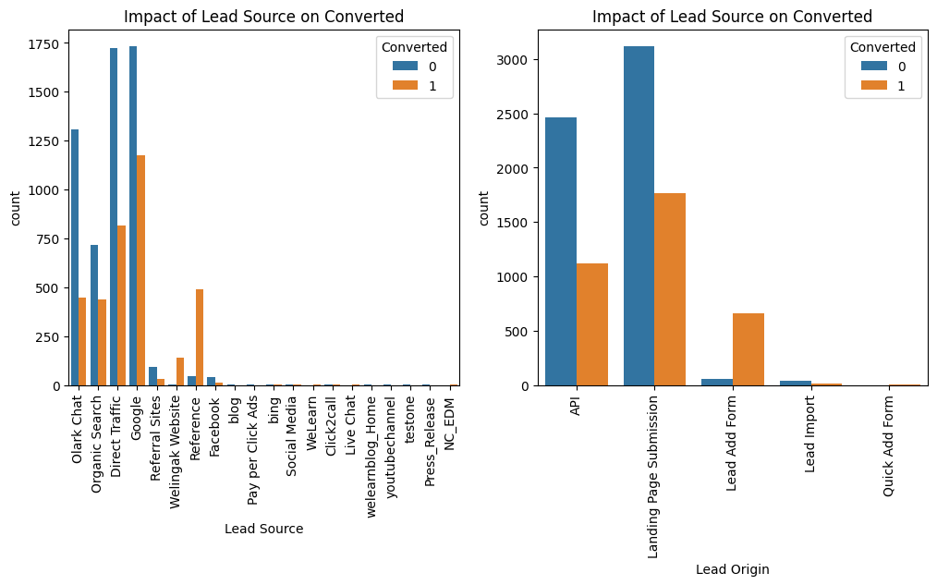
EDA

Slide 7
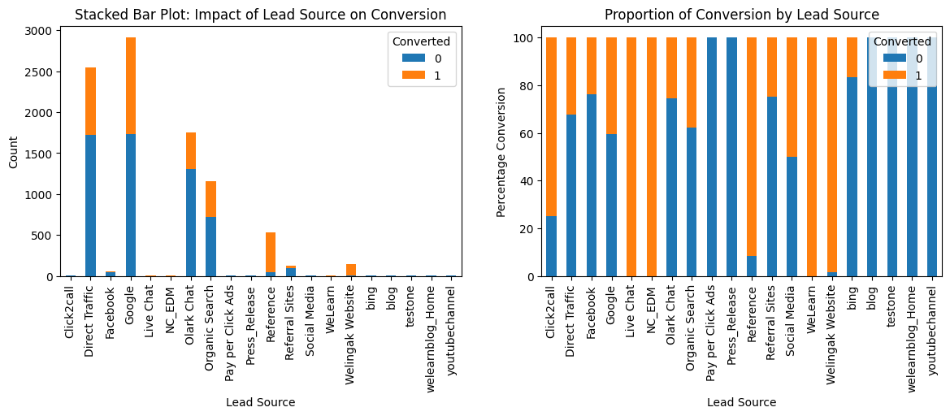
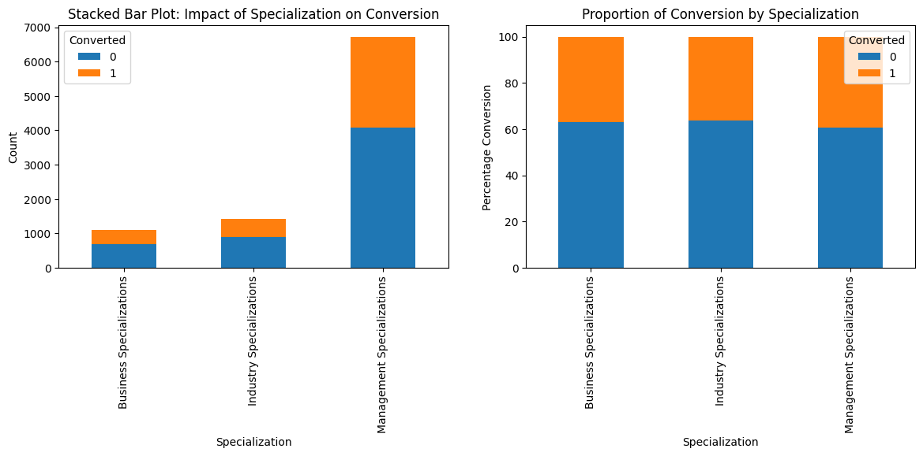
Explanatory Data Analysis (1)
Categorical variables
Impact of Lead Source on Conversion
While ‘Google’ and ‘Direct Traffic’ provide the maximum leads, ‘References’, ‘Welingak Website’ generate leads with decent number and best conversion rate
‘We learn’,’NC_EDM’,’Live Chat’ have 100% conversion, but their counts are lows
Impact of Specialization on Conversion
Management Specialization gets the maximum leads but there is no difference in the percentage of conversion based on the type of Specialization

Slide 8
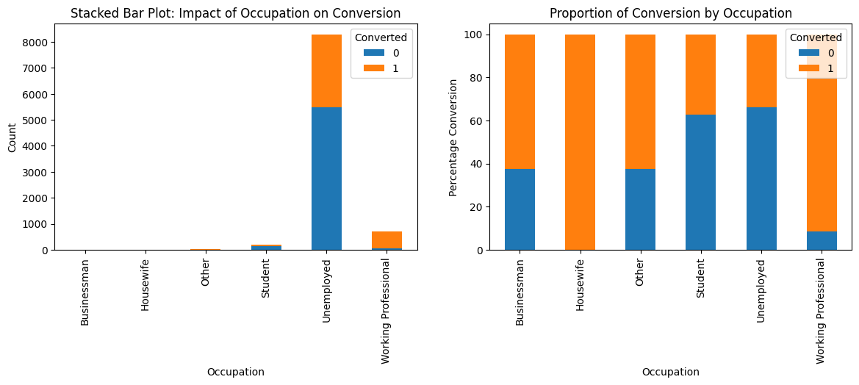
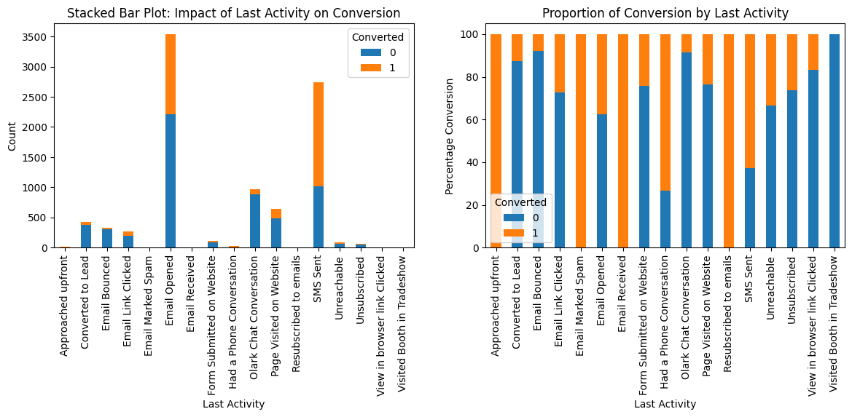
Explanatory Data Analysis (2)
Categorical variables
Impact of Occupation on Conversion
While Unemployed in the biggest pool in terms of leads conversion rate Working professionals is the best group to target.
Housewives have 100% conversion rate but their numbers are low
Impact of Last Activity on Conversion
Two major categories SMS Sent and Email Opened. SMS Conversation seems more promising than email in terms of percentage

Slide 9
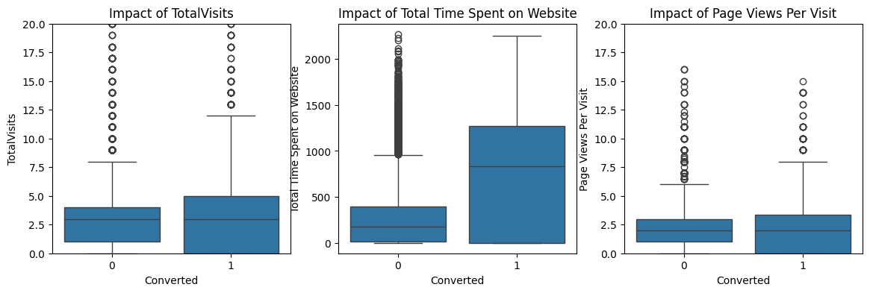
Explanatory Data Analysis (3)
Numerical variables
Only time spent on website has impact on the conversion, Visits and page views median and quartiles are nearly same for conversion.
People who spend more time are more interested.
Insight - making the website more appealing may help

Slide 10
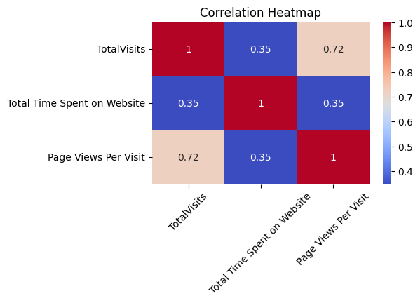
Explanatory Data Analysis (4)
Numerical variables
Total Visits and Page Views have slightly higher correlation (0.72)
Decided to retain the variables as the correlation is not that high and VIF will used post the models to remove any multi collinearity

Slide 11
Explanatory Data Analysis (5)
Categorical variables
Impact of Lead Source on Conversion
While ‘Google’ and ‘Direct Traffic’ provide the maximum leads, ‘References’, ‘Welingak Website’ generate leads with decent number and best conversion rate
‘We learn’,’NC_EDM’,’Live Chat’ have 100% conversion, but their counts are lows
Impact of Specialization on Conversion
Management Specialization gets the maximum leads but there is no difference in the percentage of conversion based on the type of Specialization

Slide 12
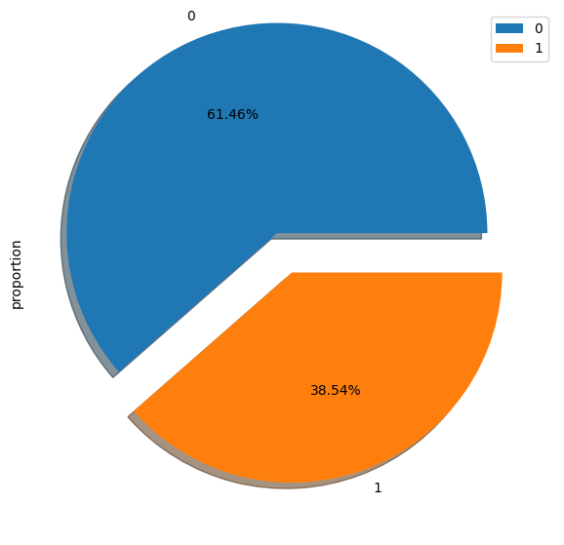
Explanatory Data Analysis (6)
Conversion Rate
Checking the conversion rate in the Leads data provided
The conversion is on expected lines as stated in the problem statement
39% Conversion rate means the data is balanced and not very skewed, Class imbalance is low

Slide 13

Model Building
Splitting the Data into Training and Testing Sets
The first basic step for regression is performing a train-test split, we have chosen 70:30 ratio.
As there were so many variables, RFE was used to select the top 15
Running RFE with 15 variables as output
Building Model by removing the variable whose p- value is greater than 0.05 and VIF value is greater than 5
Identification of cut off/threshold
Validation on test data set
Output of RFE
'Do Not Email', 'Lead Origin_Lead Add Form’, 'Last Activity_Olark Chat Conversation', 'Occupation_Working Professional', 'Tags_Busy',
'Tags_Closed by Horizzon', 'Tags_Interested in Next batch','Tags_Lateral student', 'Tags_Lost to EINS', 'Tags_Ringing', 'Tags_Will revert after reading the email', 'Tags_in touch with EINS','Tags_switched off', 'Last Notable Activity_Had a Phone Conversation','Last Notable Activity_SMS Sent'],

Slide 14
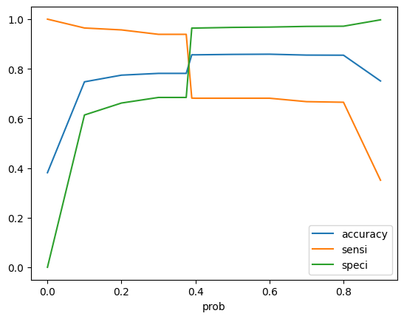
Cut off/ Threshold Identification
prob | accuracy | sensi | speci
0 | 0.381262 | 1 | 0
0.1 | 0.747372 | 0.964315 | 0.613693
0.2 | 0.774273 | 0.95661 | 0.661919
0.3 | 0.781385 | 0.938767 | 0.684408
0.34 | 0.781385 | 0.938767 | 0.684408
0.35 | 0.781385 | 0.938767 | 0.684408
0.36 | 0.781385 | 0.938767 | 0.684408
0.37 | 0.781385 | 0.938767 | 0.684408
0.375 | 0.781385 | 0.938767 | 0.684408
0.39 | 0.85637 | 0.681671 | 0.964018
0.4 | 0.856215 | 0.681265 | 0.964018
0.5 | 0.857916 | 0.681265 | 0.966767
0.6 | 0.858689 | 0.681265 | 0.968016
0.7 | 0.855133 | 0.667478 | 0.970765
0.8 | 0.854669 | 0.665045 | 0.971514
0.9 | 0.750773 | 0.35077 | 0.997251
Based on the metrices the threshold of 0.375 was selected
Since its identification of leads, its better to identify more leads with few misses than miss a few leads so Sensitivity is key here

Slide 15
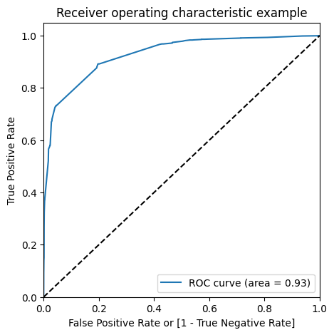
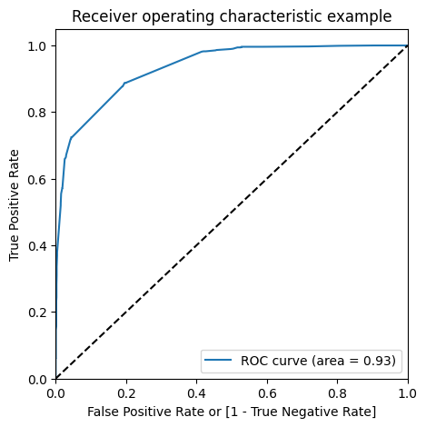
Evaluate Train and Test sets on selected threshold/cut off – 0.33
Metrices | Train Set | Test Set
Accuracy | 0.83 | 0.83
Sensitivity | 0.87 | 0.86
Specificity | 0.80 | 0.80
ROC Curve
The metrices have not varied much between Train and test sets
AUC of the curve is 0.93 which is good (large auc implies better model)
LEAD SCORE – can be derived as =
100 * Conversion probability
LEAD SCORE of cut off 33

Slide 16
Feature Importance for insights
Coefficients with positive impact on Conversion
Tags_Closed by Horizzon 8.823691
Coefficients with Negative impact on Conversion
Specialization_Other -1.909927
Tags_Lost to EINS 7.451921
Tags_Will revert after reading the email 3.541627
Tags_Busy 3.193647
Lead Source_Welingak Website 2.955038
Last Notable Activity_SMS Sent 2.716060
Occupation_Working Professional 2.456735
Last Notable Activity_Had a Phone Conversation 2.294362
Lead Origin_Lead Add Form 2.023340
Do Not Email -1.320490
Tags_switched off -1.293963
Lead Origin_Landing Page Submission -1.131528
Tags_Ringing -0.910970
Tags is a critical field that can give insights on whom to target – Closed by Horizon, Lost to ENS , Will revert after reading email are top 3 factors with positive influence and should be targeted
Specilizaiton – which not the defined category I,e, other , Candidates selecting ‘Don’t Email’ or Tags Switched off shouldn’t be targeted

Slide 17

Conclusion
It was found that the variables that mattered the most in the potential buyers are (In descending order) :
The total time spent on the Website.
Total number of visits.
When the lead source was:
a. Google b. Direct traffic
c. Organic search
d. Welingkar website
When the last activity was:
a. SMS
b. Olark chat conversation
When the lead origin is Lead add format.
When their current occupation is as a working professional. Keeping these in mind the X Education can flourish as they have a very high chance to get almost all the potential buyers to change their mind and buy their courses

